Slide 1
Inventory Management System Using Python

Slide 2
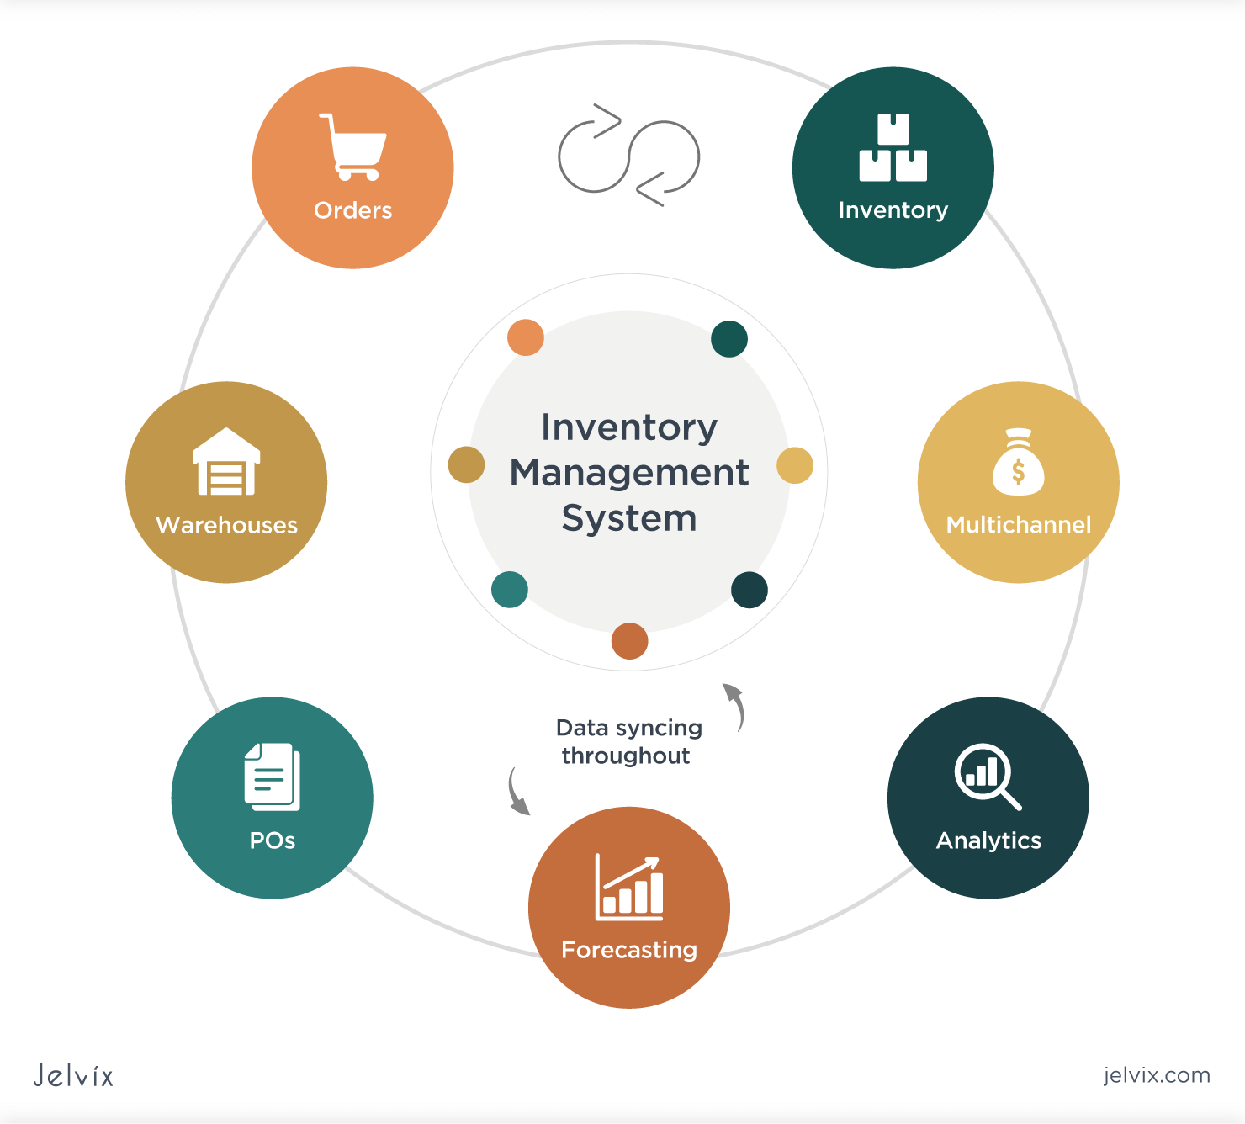
Introduction to Inventory Management Systems
An Inventory Management System (IMS) is essential for businesses to track their products and stock levels.
Python provides a versatile framework for developing efficient and user-friendly IMS applications.
This presentation will explore the key features and implementation strategies of an IMS using Python.
Notes:
Image source: https://ar.inspiredpencil.com/pictures-2023/inventory-management-and-control-system

Slide 3
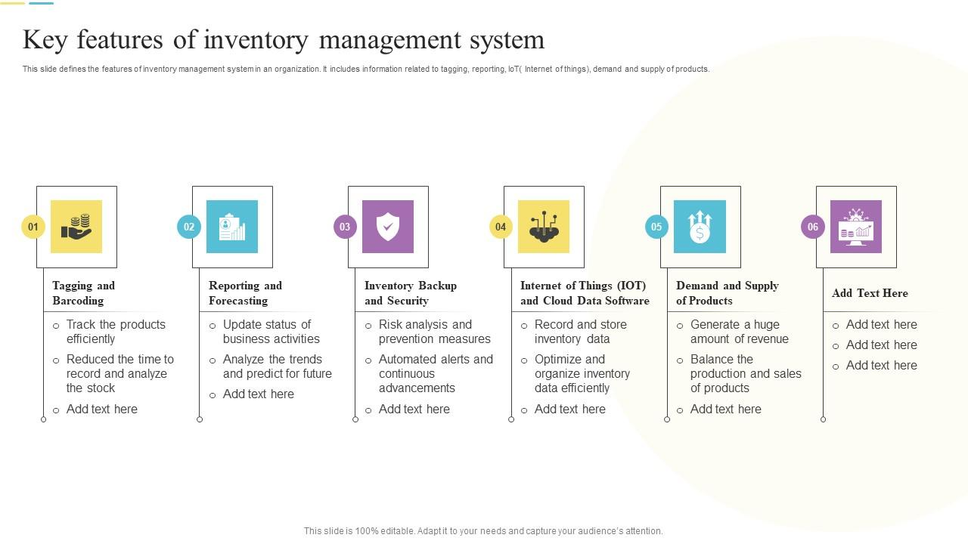
Key Features of an Inventory Management System
Real-time tracking of inventory levels helps businesses maintain optimal stock without over or under-stocking.
Automated alerts and notifications can inform users when stock levels fall below predefined thresholds.
Reporting and analytics tools provide insights into sales trends and inventory turnover rates for better decision-making.
Notes:
Image source: https://www.slideteam.net/key-features-of-inventory-management-system.html

Slide 4

Technologies and Libraries
Python's Django and Flask frameworks are popular choices for building web-based inventory management systems.
Libraries such as Pandas and NumPy facilitate data manipulation and analysis, enhancing the system's capabilities.
SQLite or PostgreSQL can be used as database solutions to store inventory data securely and efficiently.
Notes:
Image source: https://itechnolabs.ca/django-vs-flask-frameworks-in-python-development/

Slide 5
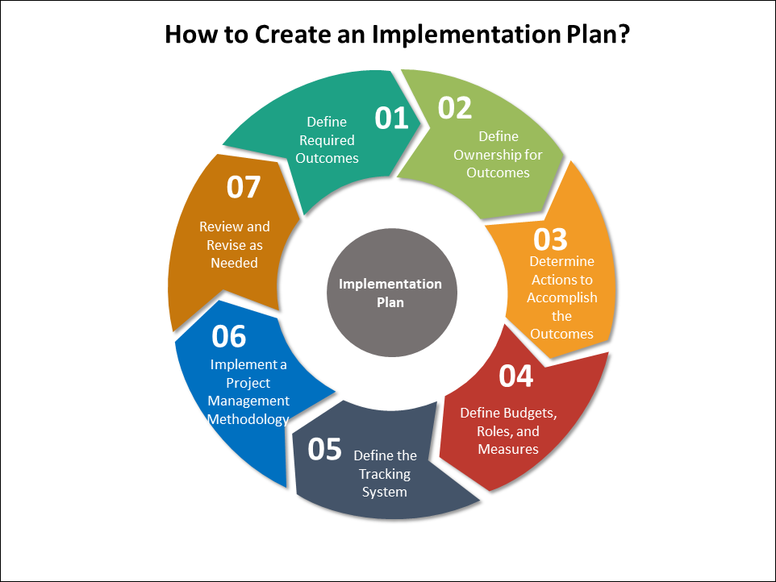
Implementation Steps
First, define the inventory requirements and specifications to tailor the system to specific business needs.
Next, develop the application structure, including the user interface and backend logic for managing inventory.
Finally, conduct thorough testing and gather user feedback to ensure the system is effective and user-friendly.
Notes:
Image source: https://www.techno-pm.com/2020/10/implementation-plan-template.html

